Slide 1
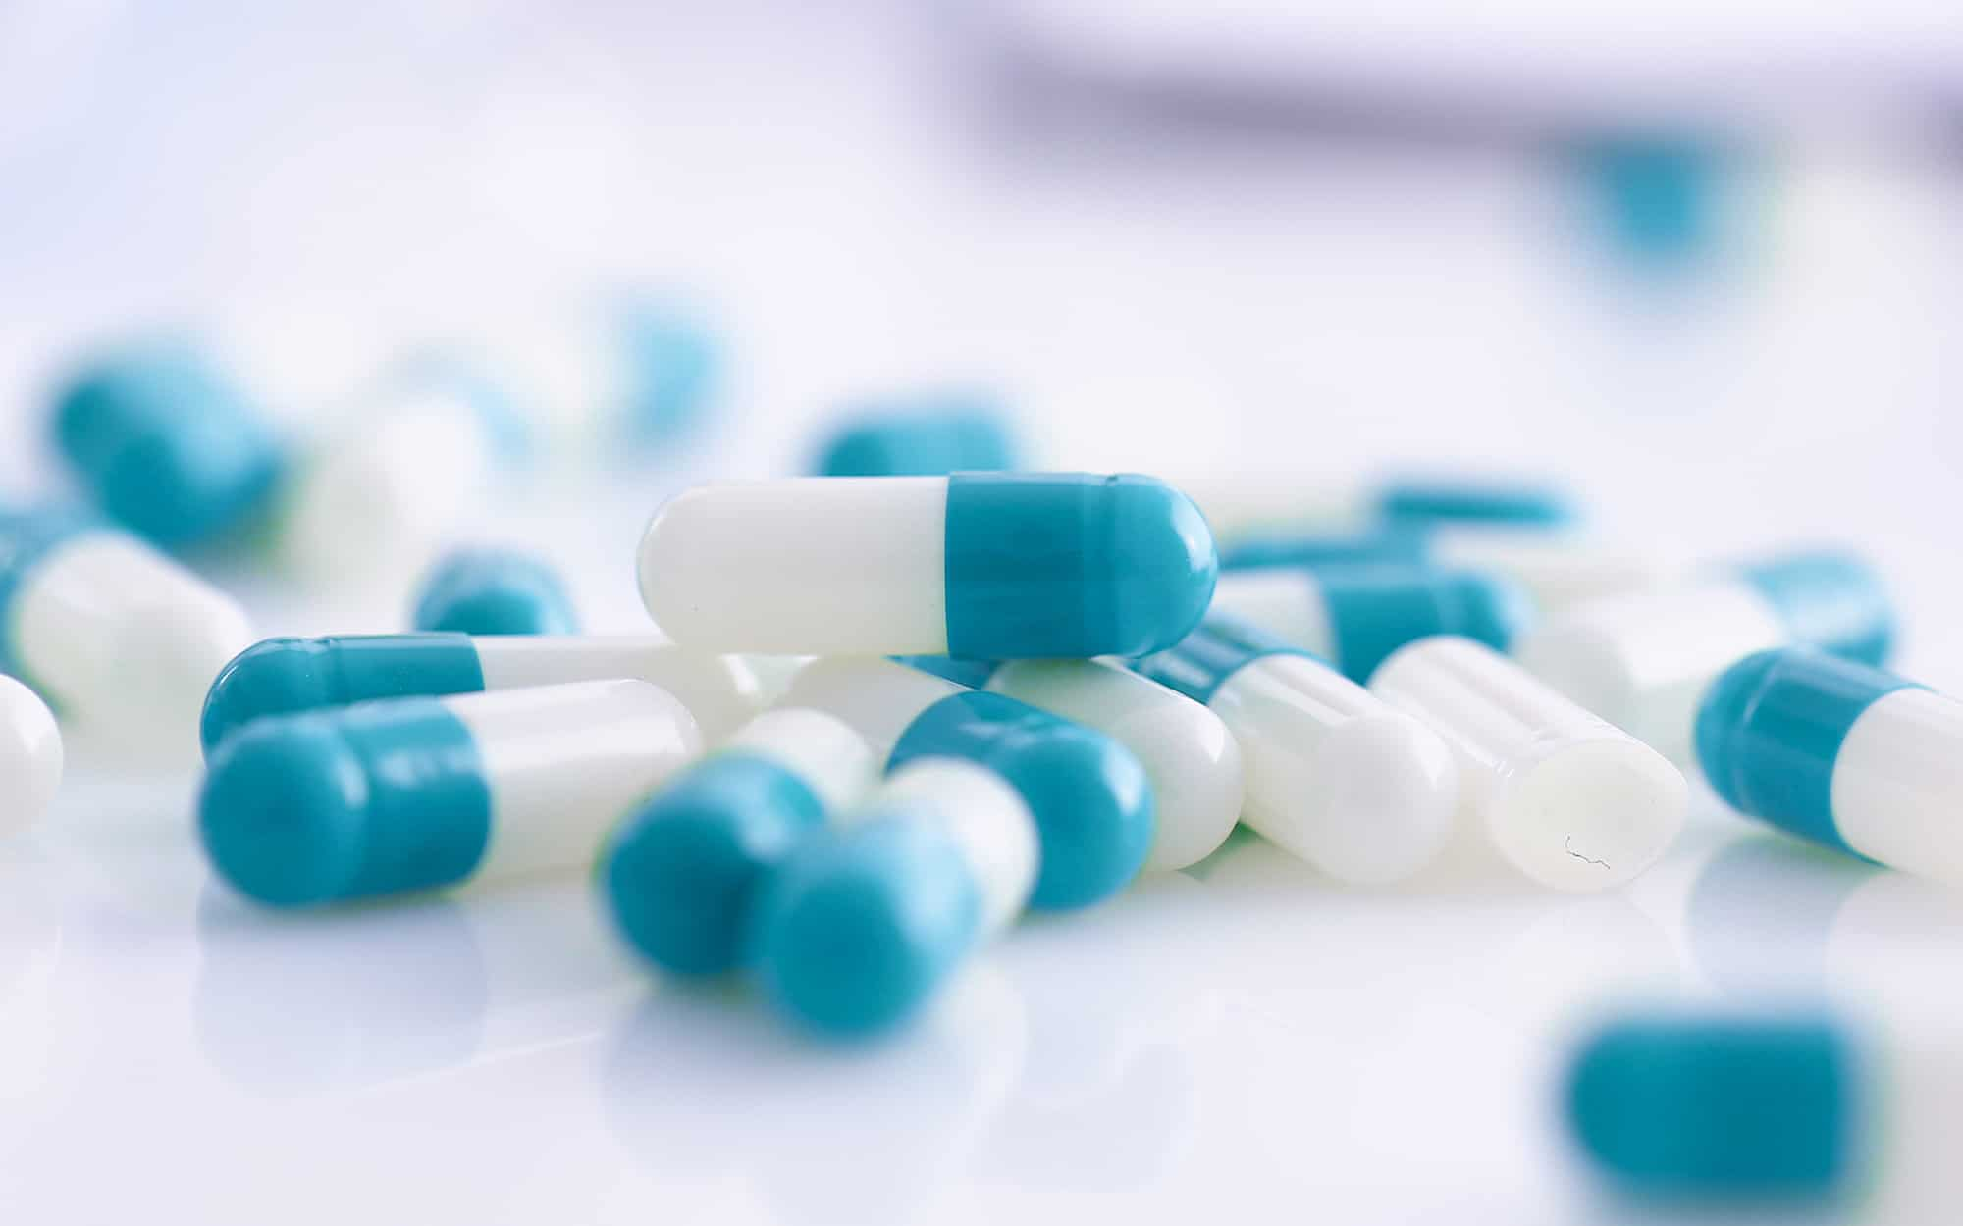
F.D.A
DATA
ANALYSIS
Vishnu Nair
ABADS
Batch 11

Slide 2
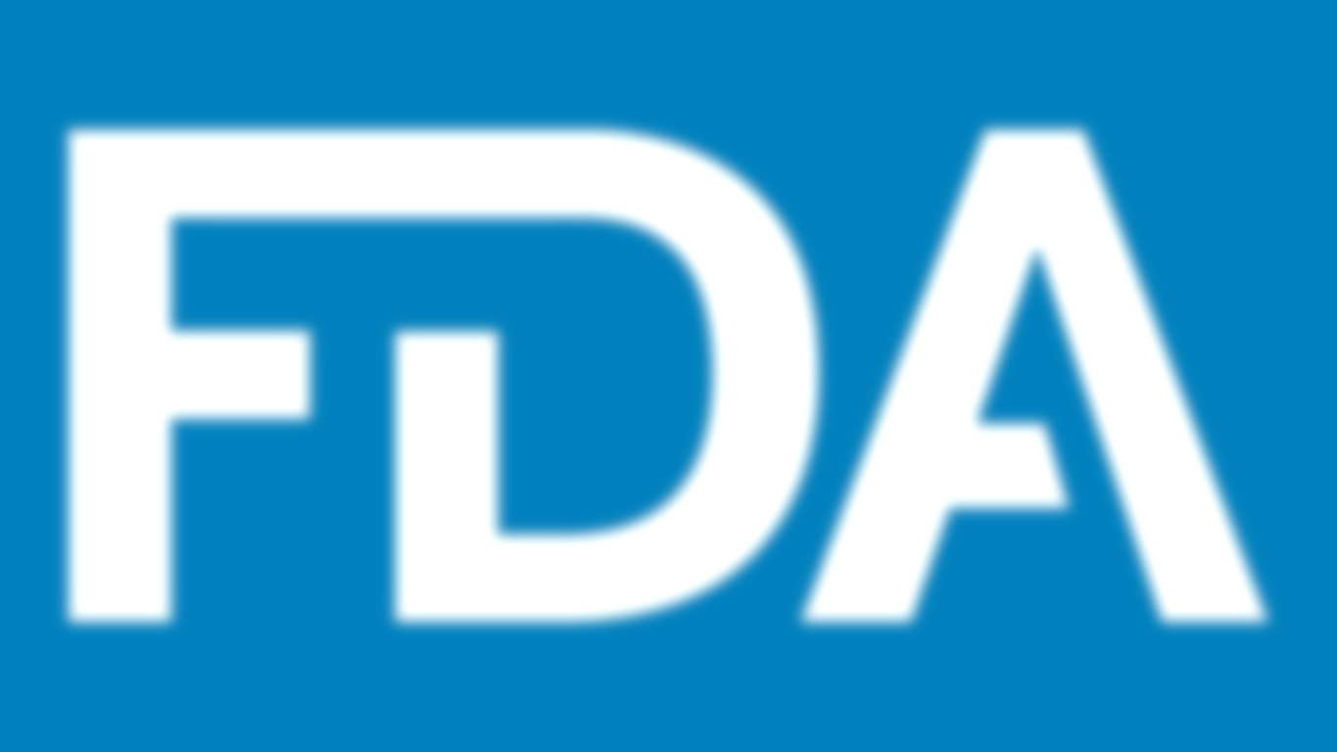

What is FDA ?

Slide 3
What is FDA ?
Championing the enhancement of public health, it contribute to expediting groundbreaking innovations that elevate the efficacy, safety, and accessibility of medical products. Additionally, I am dedicated to empowering the public with precise, science-based information, ensuring they can utilize medical products and nourishment to uphold and enhance their well-being.

Slide 4

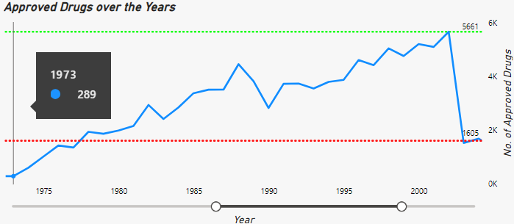
DRUG APPROVAL RATE
The commencement of the steadfastly proportional drug approval rate traces back to the illustrious year of 1973.
The ascent embarked from a modest 289 approvals, marking the inception of a noteworthy upward trajectory

Slide 5
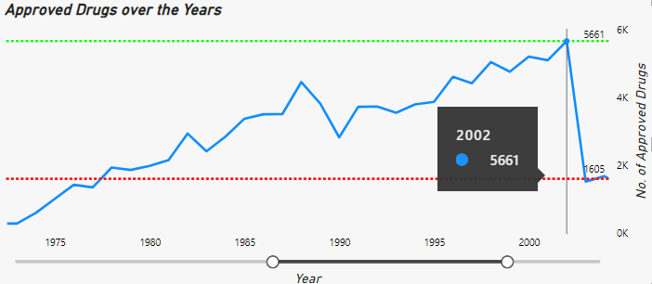
DRUG APPROVAL RATE
The ascending trajectory persisted until the illustrious year of 2002, gracefully tapering off in the subsequent annum.
In the zenith of its prowess, the approval rate soared to an unprecedented pinnacle of 5661 approvals in the illustrious year of 2002.

Slide 6
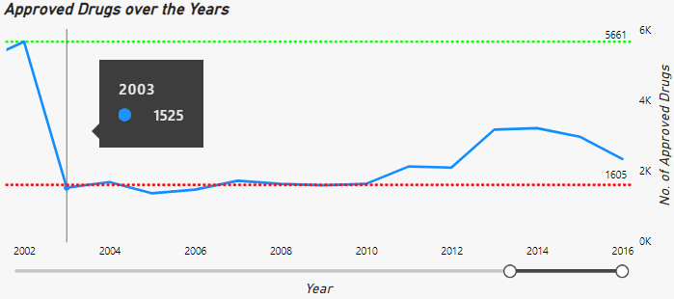
DRUG APPROVAL RATE
In the realm of regulatory evaluations, the approval landscape witnessed a notable descent in the distinguished year of 2003.
The approval rate dropped below the usual average of 1605.

Slide 7
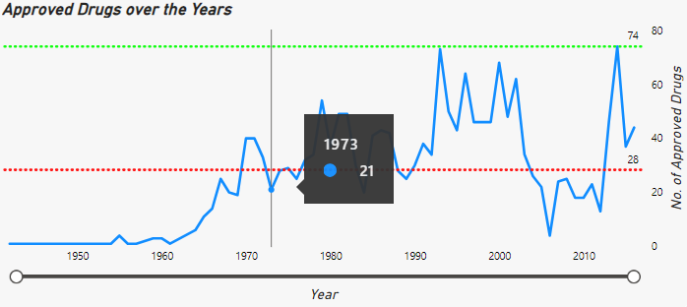
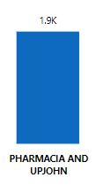
Trailblazer
SPONSOR
The initiation of an upward trajectory was catalyzed by the significant contribution of 21 approvals from the distinguished sponsor, PHARMACIA AND UPJOHN.
The cumulative approvals garnered by PHARMACIA AND UPJOHN, extending until 2016, stand at an impressive 1.9K.

Slide 8
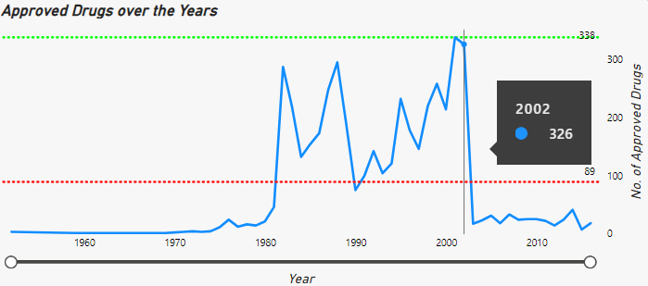

TOP PERFORMER
SPONSOR
The Pinnacle Performer of 2002, as the approvals soared to unprecedented heights, was SANDOZ, showcasing a remarkable total of 326 approvals.
SANDOZ continued to stand as a stalwart contributor, accumulating a grand total of 4.6K approvals until 2016.

Slide 9
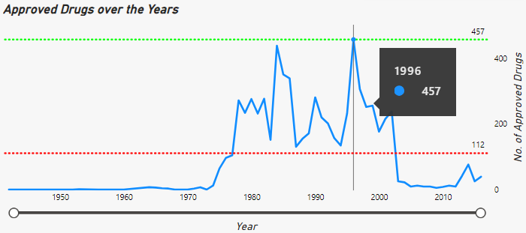

PARAMOUNT CONTRIBUTOR
SPONSOR
HOSPIRA stands out as the top contributor until 2016, securing a substantial 6.8K approvals.
Its pivotal moment occurred in 1996 with a notable 457 approvals, marking a significant imprint on the landscape.

Slide 10
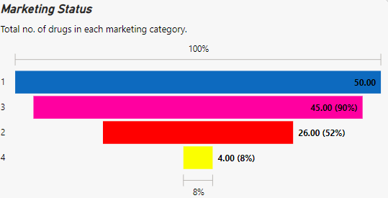
PRODUCT MARKETING STATUS
MARKETING STATUS
Code 1 holds a substantial 50% share in the marketing category.
45% by Code 2.
26% by Code 3.
4% by Code 4.

Slide 11
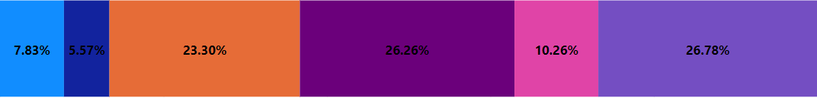
PRODUCT MARKETING STATUS
CODE 1
CODE 2
CODE 3
CODE 4
The most successful form of drug for the Product Marketing status 1 is TABLET with total approvals of 9.42K
The Drug with the highest % of approvals in Product Marketing status 1 is RISPERDONE is at 26.78%.
The biggest overall contributor till the year 2016 was HOSPIRA with a total approvals of 6.8K.
The biggest overall contributor till the year 2016 was HOSPIRA with a total approvals of 6.8K.
The biggest overall contributor till the year 2016 was HOSPIRA with a total approvals of 6.8K.

Slide 12

PRODUCT MARKETING STATUS
CODE 2
CODE 3
CODE 4
The most successful form of drug for the Product Marketing status 1 is TABLET with total approvals of 352.
The Drug with the highest % of approvals in Product Marketing status 1 is IBUPROFEN
100%
The biggest overall contributor till the year 2016 was HOSPIRA with a total approvals of 6.8K.
The biggest overall contributor till the year 2016 was HOSPIRA with a total approvals of 6.8K.

Slide 13
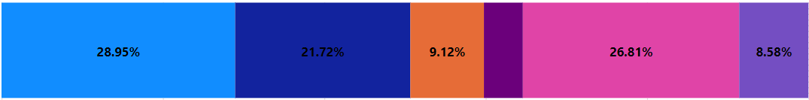
PRODUCT MARKETING STATUS
CODE 3
CODE 4
The most successful form of drug for the Product Marketing status 1 is INJECTIBLE with total approvals of 2.83K.
The Drug with the highest % of approvals in Product Marketing status 1 is HYDROCODONE BITARTRATE AND ACETAMINOPHEN is at 28.95%.
The biggest overall contributor till the year 2016 was HOSPIRA with a total approvals of 6.8K.

Slide 14
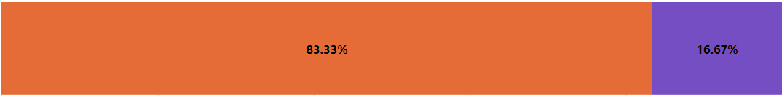
PRODUCT MARKETING STATUS
CODE 4
The most successful form of drug for the Product Marketing status 1 is TABLET with total approvals of 71.
The Drug with the highest % of approvals in Product Marketing status 1 is LAMOTRIGINEis at 83.33%.

Slide 15
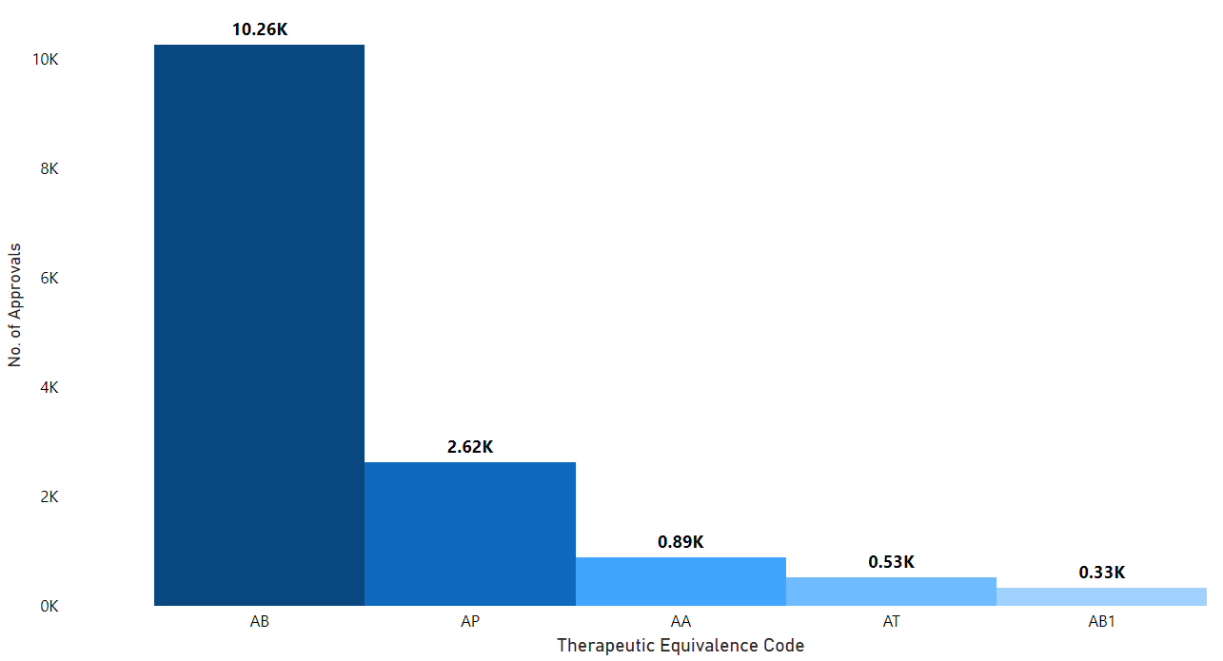
Therapeutic Equivalence
In the realm of Therapeutic Equivalence code, AB stands as the unparalleled champion, securing an astounding total of 10.26K approvals an emblem of excellence and distinction.

Slide 16
THANK YOU

